Slide 1
NYC Housing Predictions
Alan Ni

Slide 2
What?
Better way to predict a property’s price
Rodent Reports
Crime Reports
Construction projects

Slide 3


Original Dataset
PropertyShark.com
900,000 data entries
Throttle and clean
All properties in NYC
Estimated price is questionable

Slide 4
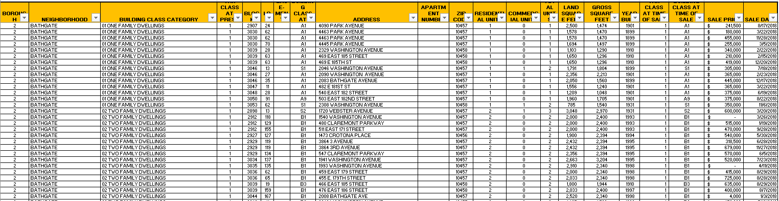
NEW Data

Slide 5
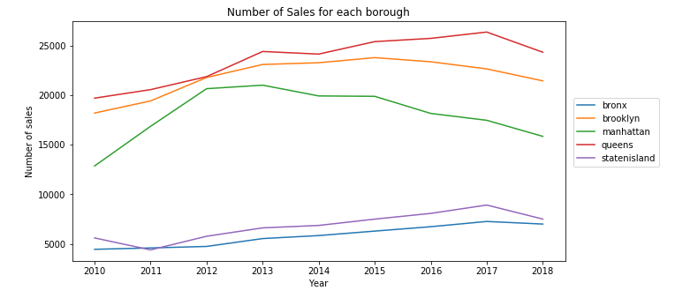
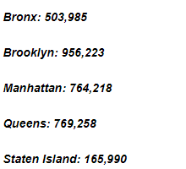
Total Sales

Slide 6
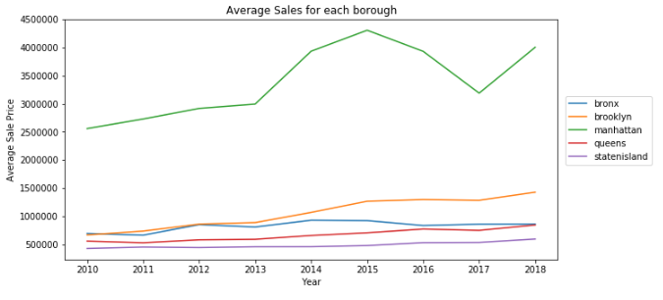
Average Sales Price

Slide 7
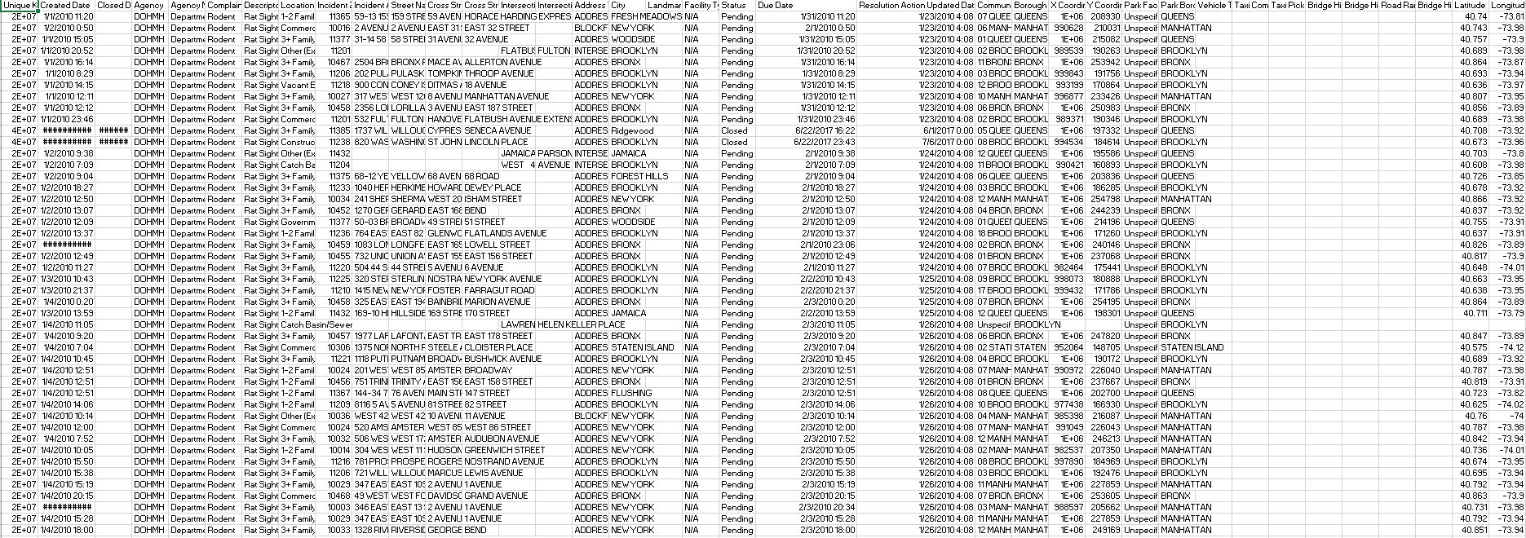
Rodent Data Original

Slide 8
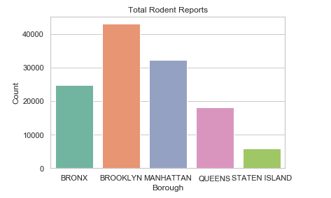
Rodent Report

Slide 9
Rodent heat map

Slide 10
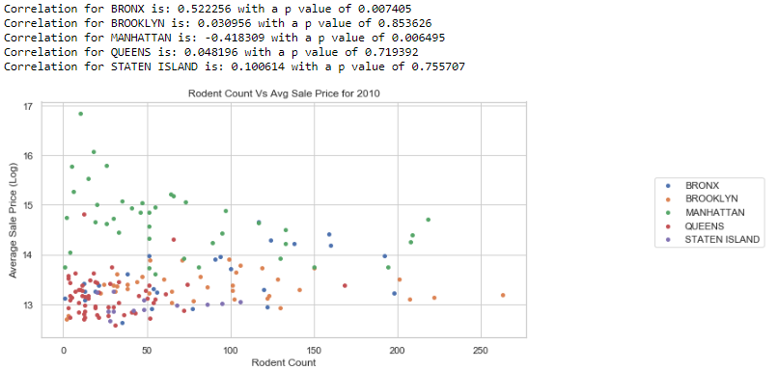
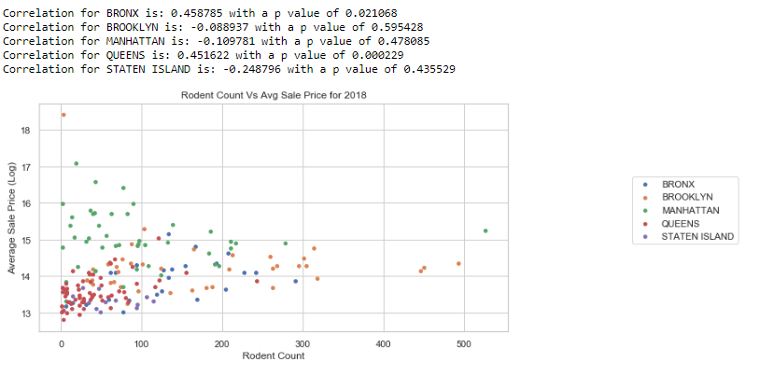
By Zipcode

Slide 11
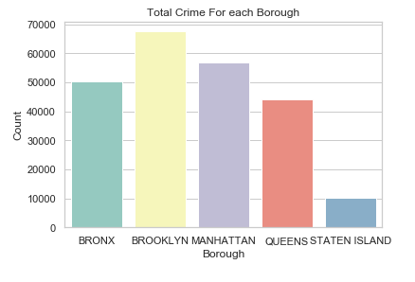
Crime

Slide 12
Rodent vs Crime

Slide 13
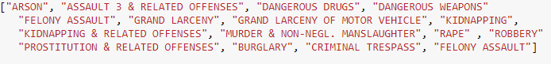
Exclude crime
Only include violent crimes and felonies
Sum of zip code level -> merged into main dataset

Slide 14
Construction data
Missing Addresses (Non-existent)
Total sale price vs Average
Multiple projects per property
“Free projects”

Slide 15
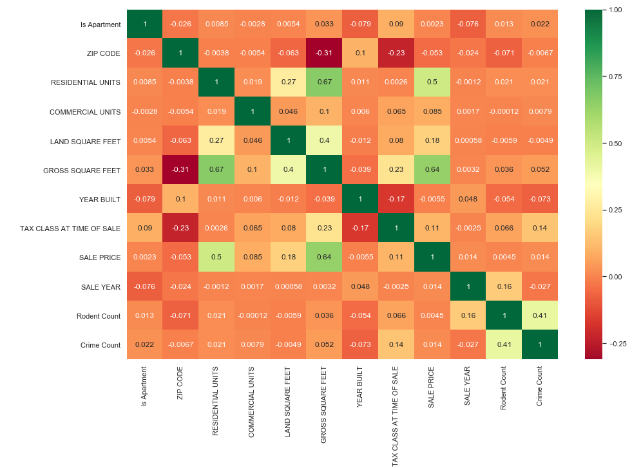
Main dataset afterwards

Slide 16
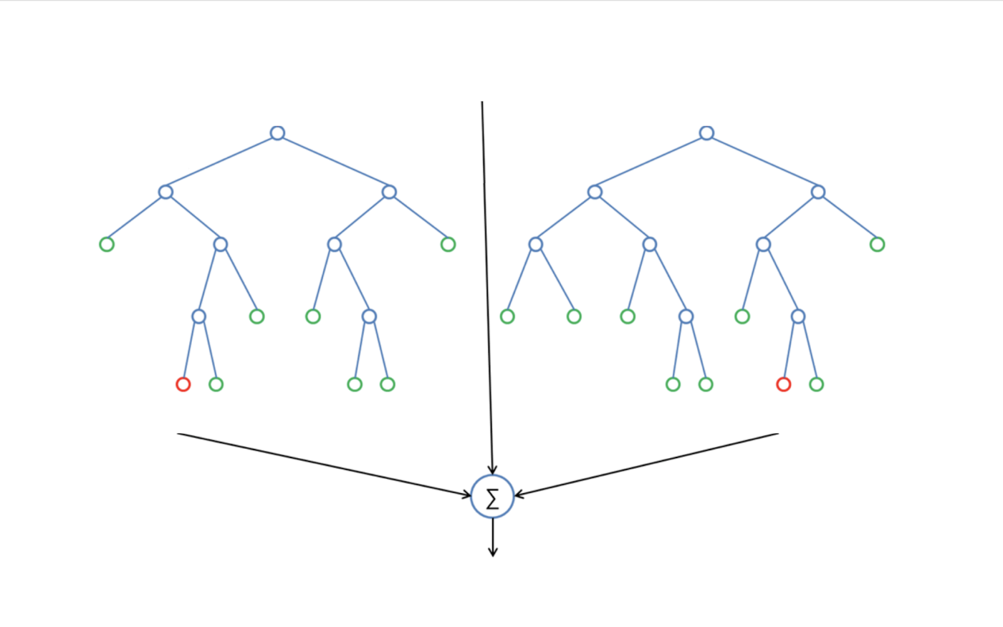
Random Forest
Random Sampling can overlap
Trees independently trained
Robust to outliers
Max depth = 50
Estimators = 100
Score = 73%

Slide 17
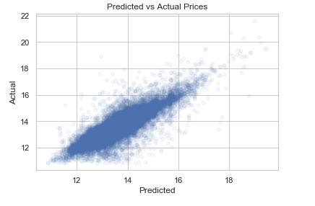
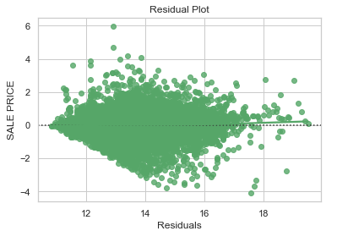
Random Forest Plots

Slide 18
Jack Knife Random Forest
Similar to random forest before
No overlap for samplings
Same dimensions as boot strapped random forest
R squared score = 63%
Personal Implementation

Slide 19
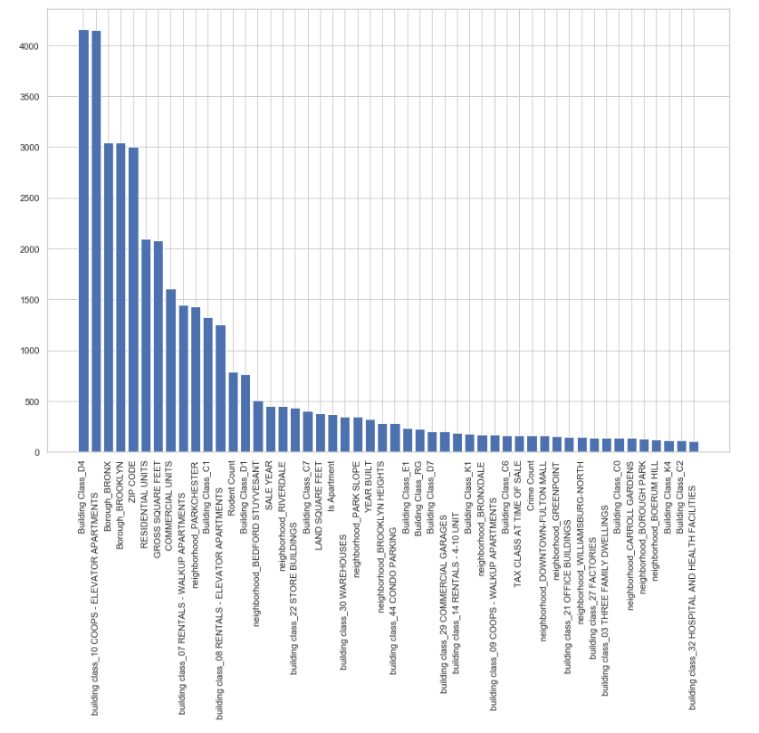
SelectKbest

Slide 20
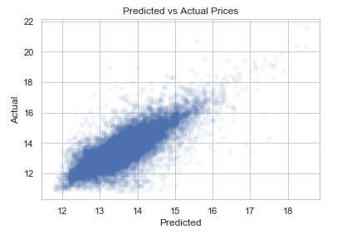
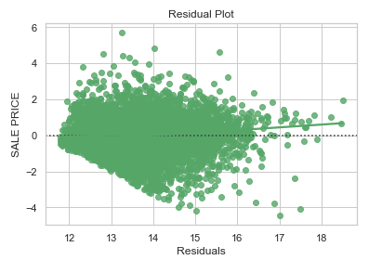
Jack Knife Plots

Slide 21
Fin

